Slide 1
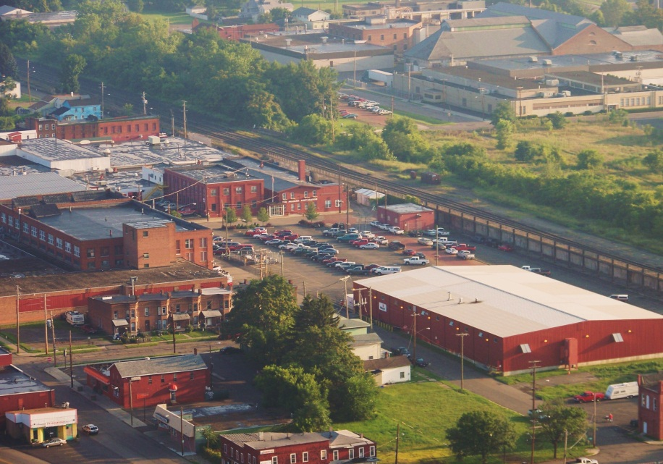
Hilco Training 2012 Gas Filtration
Orlando, FL

Slide 2
Hilco Gas Filters/Separators and Strainers
Hilco Gas Filters/Separators and Strainers can be used for any gases
Experience to date has mainly been natural fuel gas applications
Goal is to remove solid and liquid contaminate to desired levels as not to plug or foul fuel nozzles
Current customers are GE, Siemens, GE Packaged Power and several end users
Notes:
Hilco has been involved in gas filter applications for several years. Recently, we have focused efforts to develop offerings for specific OEM applications. The main applications developed were custom gas strainers for GE gas turbines and Gas Filter Separators for Siemens gas turbines. These applications are fuel gas applications, however have applied and can apply these technologies to any gas. The goal of a strainer or filter separator is to remove solid and/or liquid contaminate from the gas stream to specified levels. In the case of fuel gas we are generally protecting the fuel nozzles and orifices from being fouled or plugged. Plugged fuel nozzles can greatly effect turbine performance.

Slide 3
Gas Filters/Separators
Solid and liquid contamination removed by filter media through surface and depth filtration
Liquid contamination also removed through separation as it passes through cartridge.
Solid and liquid contaminate also removed through gravity and direction changes in the vessel.
Notes:
How do we go about removing the contaminate? We remove the contamination by use of a media that utilizes surface and depth filtration. Liquid contamination is removed by separation process as the gas passes through the media. Both solid and liquid contaminate is also removed through gravity and directional changes within the vessel.

Slide 4
Typical Gas Filter/Separator
Can design and build any size
Cartridge flow inside to outside
Condensate level gage
Differential transmitter
Siemens Fuel Gas 501F shown
10” connections
600 psi ASME Code
500 F operating temperature
30.86 lbs./sec flow
Notes:
To date we have built several filter/separator units for end users and OEM’s. Basically we an build any size up to our ability to move the filter around our shop. Cartridge flow is inside to outside rather than our normal L/O filter flow which is outside to inside. Typical options can include differential pressure transmitters, condensate level gages, condensate auto dump valves. The unit shown is a Siemens unit with 10” connections, 600 psi code design.

Slide 5
Design Codes and Standards
Design Codes Used by Hilliard for Filter Vessels
ASME Code Stamped
GOST R (Russian)
DOSH (Malaysia)
AS1210 (Australian)
CE (Europe)
NR-13 (Brazil)
Chinese Pressure Vessel Code (China) -Pending
Seal Gas Filters
Notes:
We should always remember that we can handle the various pressure vessel codes from around the world. This can be a strength over our competitors.

Slide 6
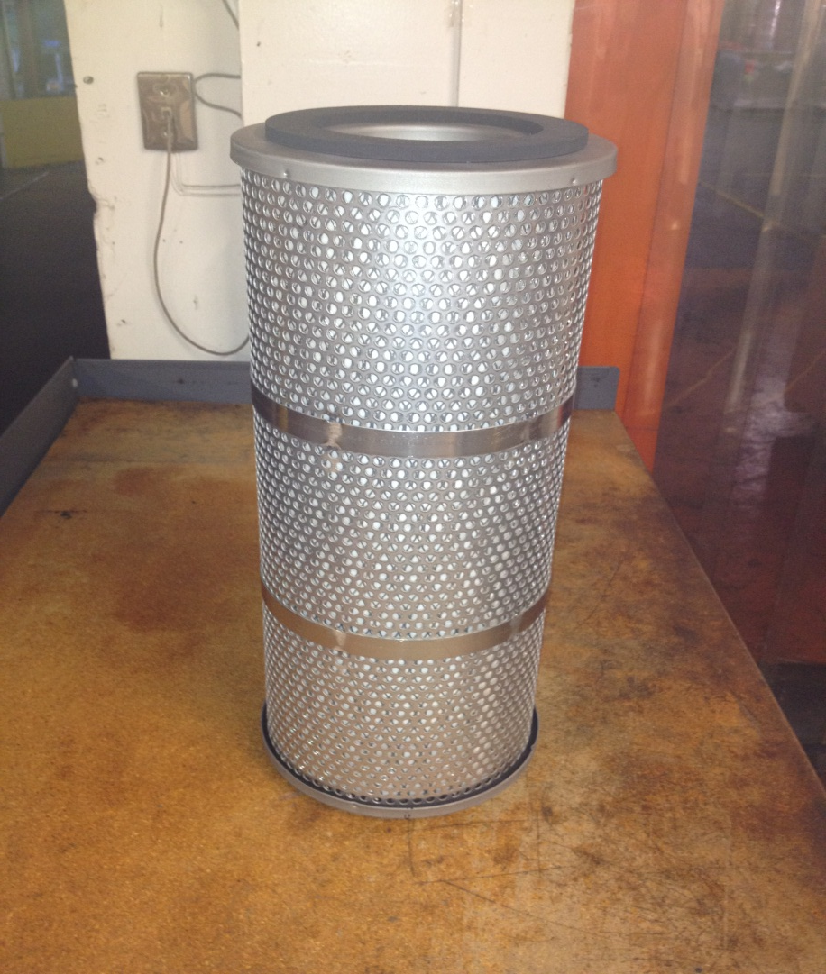
Filter/Separator Cartridge Sizes Utilized AA820-00-C – 20 ¼ L, 8 ¾ OD, 4 ¼ ID
Replaces National Part #
2710E2
Notes:
Lets look at the various sizes of cartridges we utilize and design the gas filter housing around. The different cartridge sizes along with using multiple cartridges per housing allow us to design the most economical housing. Incidentally our AA820-00-C interchanges directly with National Element # 2710E2. National filtration, or Clark Reliance today have many housings in fuel gas applications on Siemens turbines that use this cartridge.

Slide 7
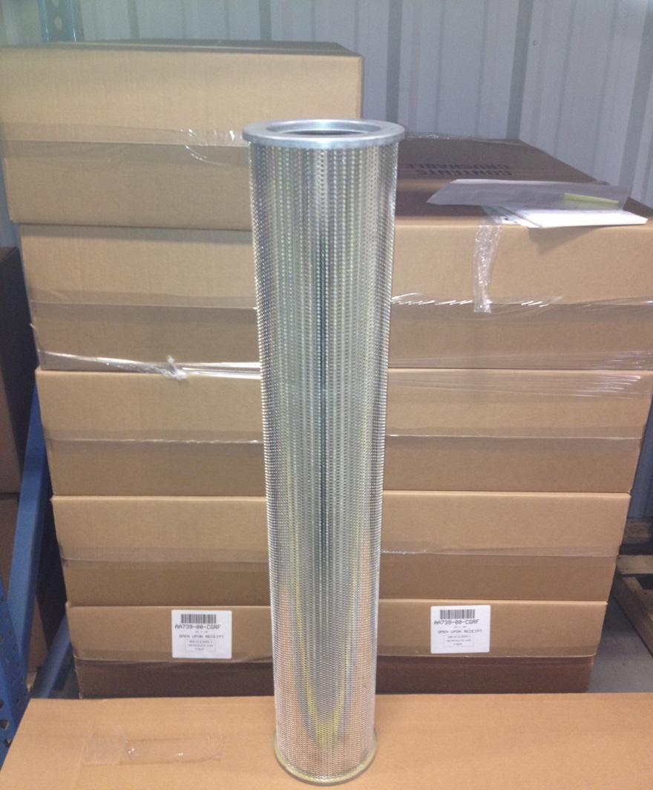
Filter/Separator Cartridge Sizes Utilized AA739-00-CGRF- 30 5/8 L, 6 ½ OD, 4 1/8 ID
Hilco Size
Notes:
The AA739 Filter/Separator cartridge is proprietary to Hilliard. Therefore, we try to use this size where we can so the cartridge business comes back to us.

Slide 8
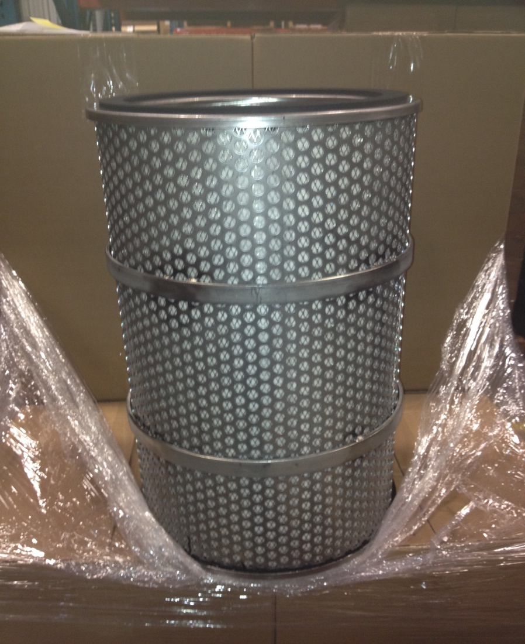
Filter/Separator Cartridge Sizes Utilized AA1624-00-C – 24 7/8 L, 15 ½ OD, 11 ID
Replaces National Part #
2710E1
2710H2
Notes:
Lastly we have our largest size filter/separator cartridge that was used in the large Siemens Gas Filter I showed you earlier. Notice all the cartridges have heavy outer ambient to prevent burst from the inside out flow. Burst pressures exceed 100 psid for our filter separator designs. Cartridge material going downstream contaminating fuel nozzles will likely cause a shutdown of the turbine and the plant.

Slide 9
Filter/Separator Cartridge Construction
Media is multiple layers of synthetic materials supported on both sides by epoxy coated screen
Stainless steel end caps
Inner and outer core is heavy gauge stainless perforated, reinforced by stainless bands
Viton Gasket material up to 450 F
Other gasket materials available for higher temperatures
Notes:
Our filter separator cartridges are constructed of multiple layer of synthetic materials supported be coated or stainless screen. Most of the time all components are stainless because we are striping moisture out of the gas. Heavy ambients and center cores. Also, many times in fuel gas applications the gas is preheated to facilitate complete combustion and increase efficiency. Therefor the cartridge is designed to withstand gas temperatures to 450 F for the standard designs.

Slide 10
Filter/Separator Cartridge Performance
Particle removal efficiency 99% @ 0.5 to 3 Micron
Liquid removal efficiency 99% @ 0.5 to 8 Micron
Clean Pressure Drop 2-3 psid @ 80 F and
500 Actual Cubic Feet Minute (ACFM) for AA820-00-C
300 ACFM for AA739-00-CGRF
1000 ACFM for AA1624-00-C
Notes:
The heart of our filter separator is the cartridge and the performance. Generally the turbine oem in the case of fuel gas, or the process in the case of filtering other gases dictate the cleanliness requirements. Particle and liquid removal efficiencies stated here are generally industry standards that you will find in the GE and Siemens specs. That is…… Note that we size the cartridges and filter to achieve a clean pressure drop of 2-3 psid and the rule of thumb is 500 ACFM for 820 size, 300 CFM for our 739, and 1000 for the AA1624. We may want to modify this sizing if the gas being filtered is excessively dirty or has a lot of moisture.

Slide 11
Efficiency Testing of Filter/Separator Cartridges
Modified DOP Test Procedure
Notes:
How do we determine the efficiency and prove to our customers that we meet their specifications. We have constructed a test rig that utilizes free air loaded with dirt and moisture and look at the inlet and outlet conditions to prove our cartridge will meet their expectations.

Slide 12
Effluent (Outlet) Test Data
Notes:
Here is a graph of what’s coming out of the cartridge from performing the testing in our lab. Have around .20-.25 micron coming out with a total mass of 400 mg/Cu meter.

Slide 13
Influent Particle Size
Notes:
Coming in to the filter the average particle size is around 1 micron, remember from the last slide the average size coming out is .25 micron. Therefore, we are definitely removing 99% of the particles .5 to 3 micron.

Slide 14
Influent PPM
Notes:
This is the total mass coming into the filter at about 240,000 micrograms per cubic meter, or 240,000 PPM, note from the first performance slide the outlet of the filter was about 400 microgram/Cu meter or 400 PPM. Significant reduction.

Slide 15
Third Party Verification of Particle Removal Per ASHRAE 52.2
Notes:
Here is a third party verification of our cartridge performance. They use a bit different testing method, but the results are the same for .5 micron and above we are at least 99% efficient.

Slide 16
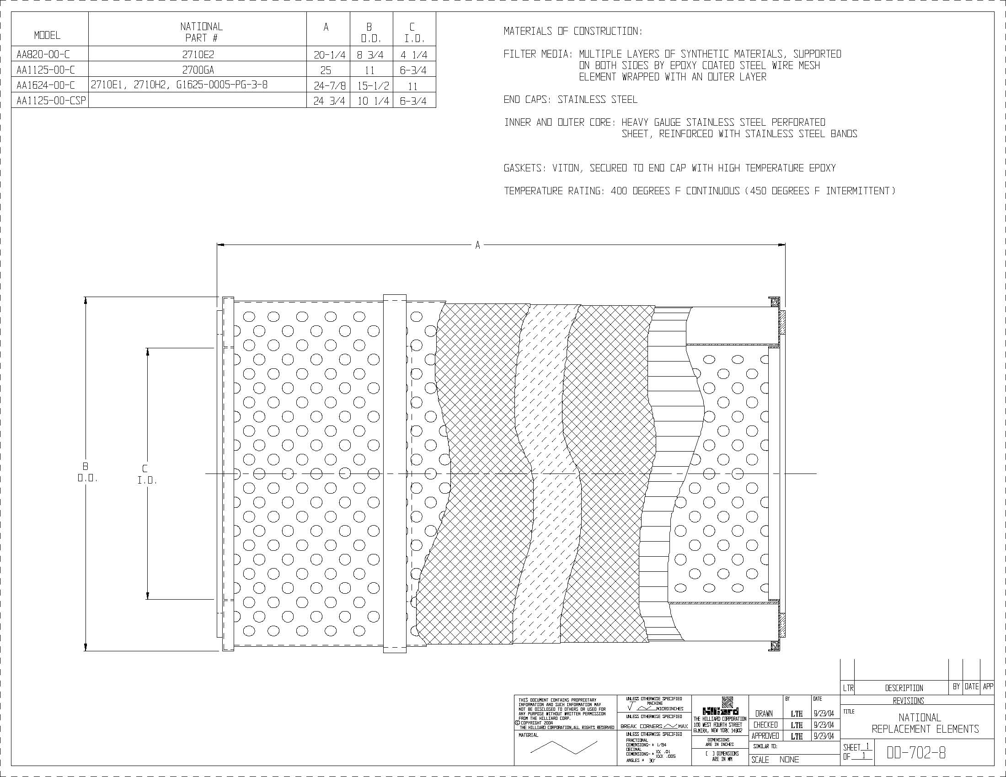
Competitor Replacements
Notes:
Again we have a cartridge plant that runs about 30-40% capacity so we need to get out there and push our elements performance and benefits to increase our business.

Slide 17
Benefits of Hilliard Replacements
Meets Siemens requirements
Approved by Siemens, GE, MHI and other OEM’s
Uses Viton Gaskets and high temperature Viton for heated gas applications
Competitors use Silicon gaskets that degrade with drip gas

Slide 18
Market and Customers
Where to look for opportunities and applications…
Engineering Companies doing work for Power Plant (Fuel Gas), Gas Gathering and Transmission, Refineries
Power Plants, Gas Transmission, Refineries
Siemens 501, F5000 sites for National Replacement Elements
Gas Transmission and Injection for Compressor Seal Gas
Notes:
Where do we look for these opportunities:

Slide 19
Gas Strainers
Hilco has been making simplex and duplex strainers for liquids for many years
Recently have pursued more gas strainer opportunities
Used Stainless baskets in “bag housing” design
Specified in 2011 by GE for custom fuel gas strainer (last chance) just ahead of the gas turbine fuel metering
Extensive design and testing on custom basket design
As with Filter/Separator housing can provide all the international pressure vessel codes
Notes:
We have looked at the filter sep, now let look at another product we have developed over the last three years, gas Strainers. In the past we have made strainers for liquid applications, however the filtration mechanics for gas are similar so its not a big leap to go from liquid to gas and the strainer side. Through a opportunity at GE extensive testing was done to develop a strainer basket design that would meet GE requirements. Mote once again we can apply all the design codes mentioned earlier to the vessel

Slide 20
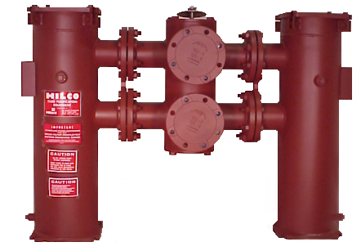
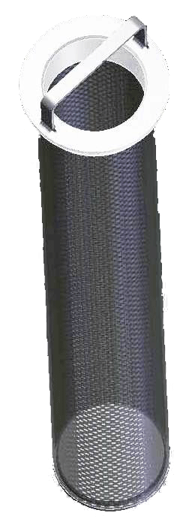
Strainer Types
Bag housing style
Custom threaded baskets multiple baskets
Notes:
Basically we have two versions, one that uses a drop in basket with metal to metal seal, and a threaded basket.

Slide 21
Strainer Element Design
Bag housing style strainer elements available in carbon and stainless steel single layer mesh sizes 10, 25, 40, 60, 104, 150, and 200 micron available
Custom threaded strainer elements are layered element with Carpenter 20 sintered to a support screen rolled with a heavy stainless ambient
Highly corrosion resistant
Fine filter mesh is sintered (bonded) to heavier mesh
No downstream egression of screen or element
Robust design can be easily cleaned many times
10, 25, 40, 60, 104, 150, and 200 micron available
Notes:
In the bag housing drop in basket we offer all the single layer mesh sizes that result in 10, 25, 40, and on up to larger particles. In our custom threaded in design we use for GE we offer a layered basket with support screen and heavy ambient. Note that the threaded design offers advantages over the bag style.

Slide 22
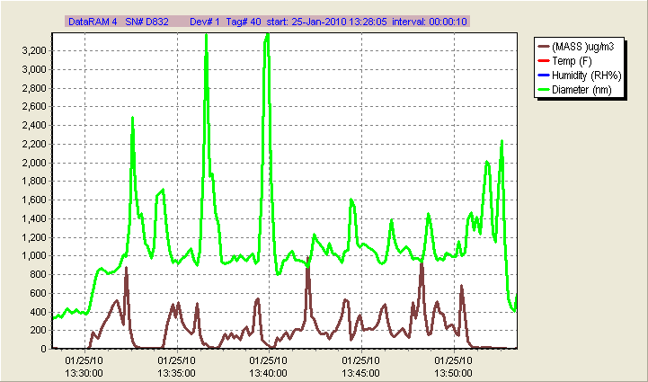
Efficiency Testing
Notes:
In a screen design we consider those to be a absolute filter. Another words particle larger than the screen will not pass. Note in this particular test the strainer is allowing through on average 2 micron particles and about 400 milligrams/ cubic meter

Slide 23
Dirt Holding Capacity
Notes:
Dirt holding capacity is a important aspect of any filter element or strainer as it translates to life between change of a cartridge or cleaning of a strainer.

Slide 24
Market and Customers
Where to look for opportunities and applications…
Engineering Companies doing work for Power Plant (Fuel Gas), Gas Gathering and Transmission, Refineries
Power Plants, Gas Transmission, Refineries
GE gas turbine installations that have Pall strainers
Gas Transmission and gas gathering
Notes:
Here is a list of where to look for opportunities…very similar to the filter separators.

Slide 25
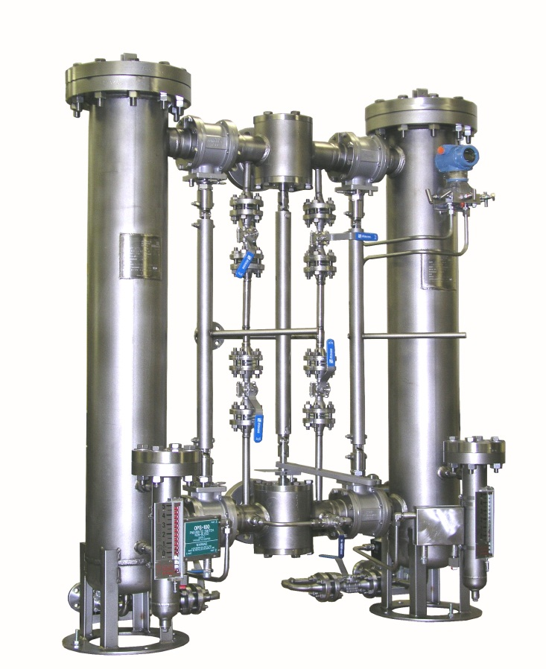
Gas Conditioning Skids
Can provide complete turn key skids
Transfer and block valves
Complete automation
Liquid level gauges
Automatic dump valves
DP switches and transmitters
Controls package
Notes:
Note that Hilliard has the capability to engineer, design, manufacture, and test complete gas conditioning skids. Several of these conditioning skids have been delivered to end users and OEM’s. Note we not only provide the filters but the controls, block and bleed valves, dump, valves, transmitters, controls, to provide our customer a complete solution.

Slide 26
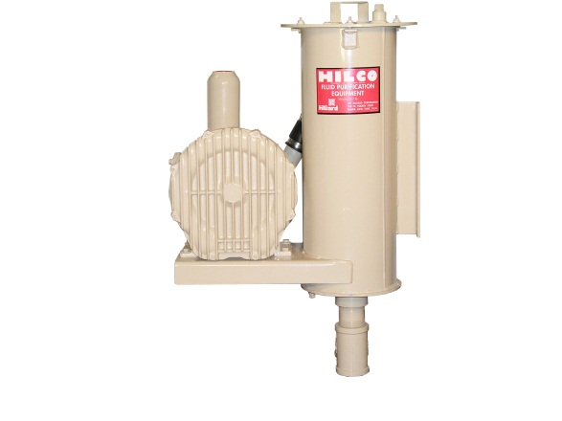
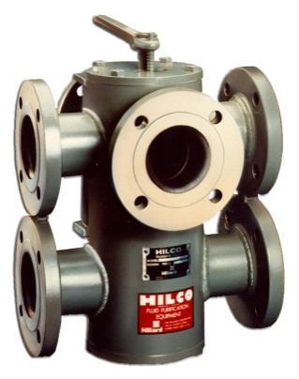
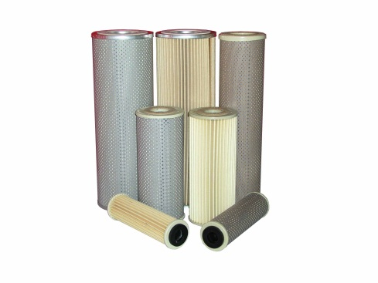
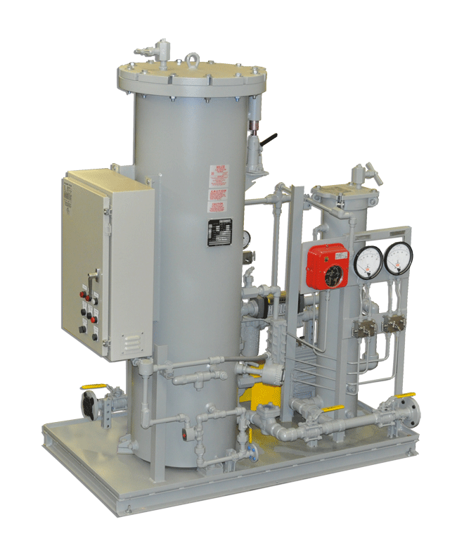
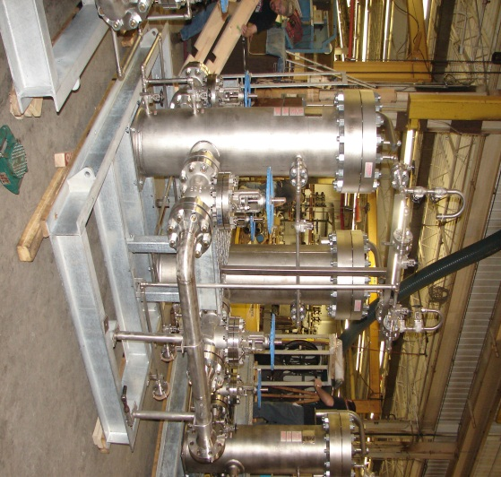
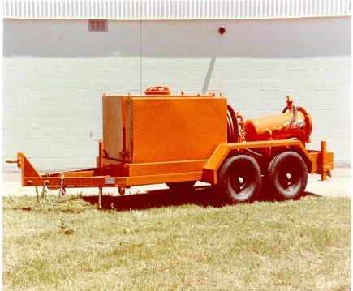
Questions

